Slide 1
Car price regression
By: Kholod Alshehri
Notes:
Are your classroom colors different than what you see in this template? That’s OK! Click on Design -> Variants (the down arrow) -> Pick the color scheme that works for you!
Feel free to change any “You will…” and “I will…” statements to ensure they align with your classroom procedures and rules!

Slide 2
INTRODUCTION
With the technological development, cars have become a necessity for the majority of people.
This linear regression project aims to predict the prices of the cars in the future based on the most important characteristics that affect its value in the market.

Slide 3
PROBLEM STATEMENT
What is the effect of features on cars prices ?
OPJECTIVE
Predict cars prices Based on specific cars features.

Slide 4
DATA SET
The data to be tested in this project are scraped from yallamotor.com/ar
6308 rows & 9 columns

Slide 5
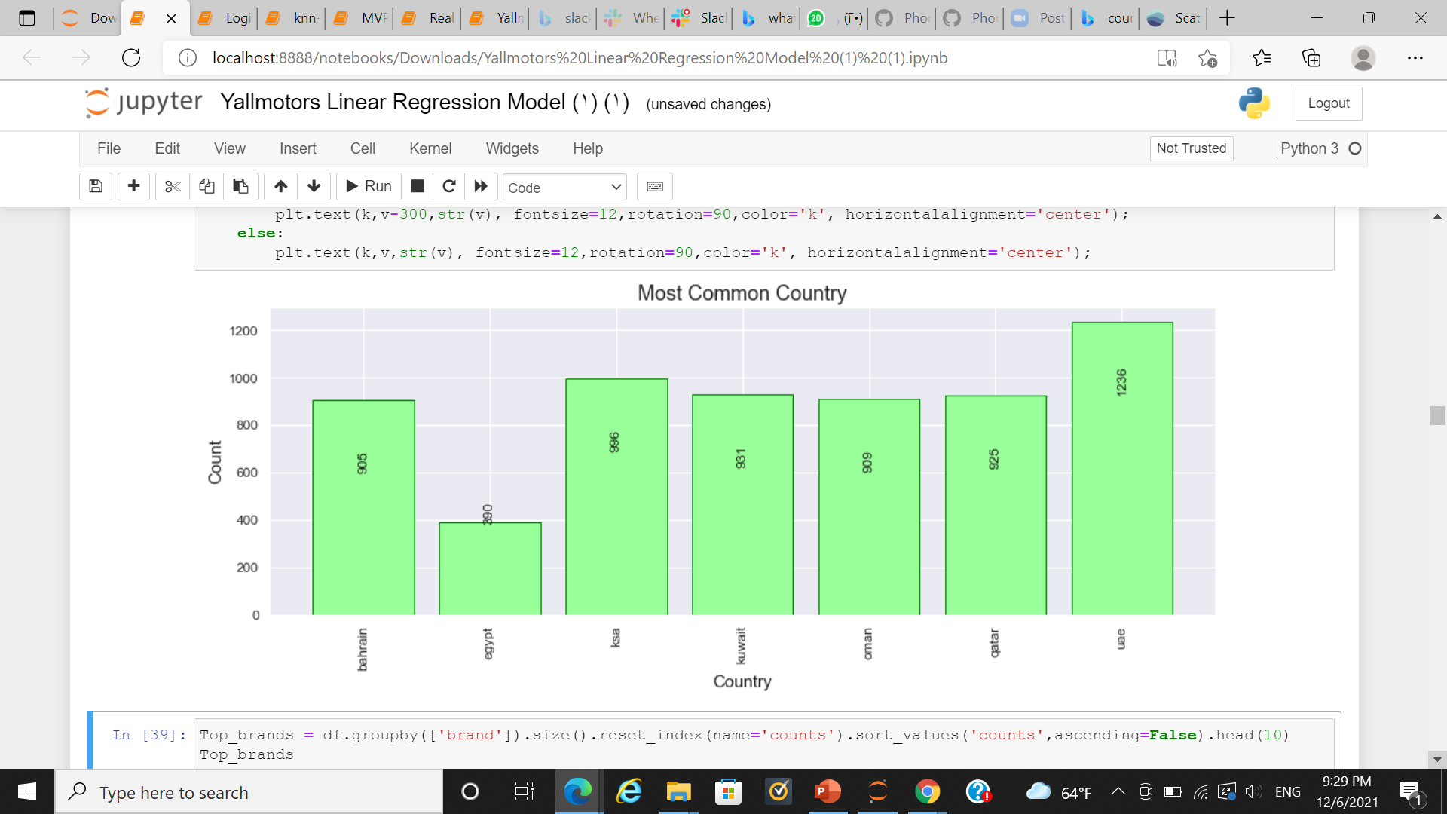
Data Cleaning & Visualization

Slide 6
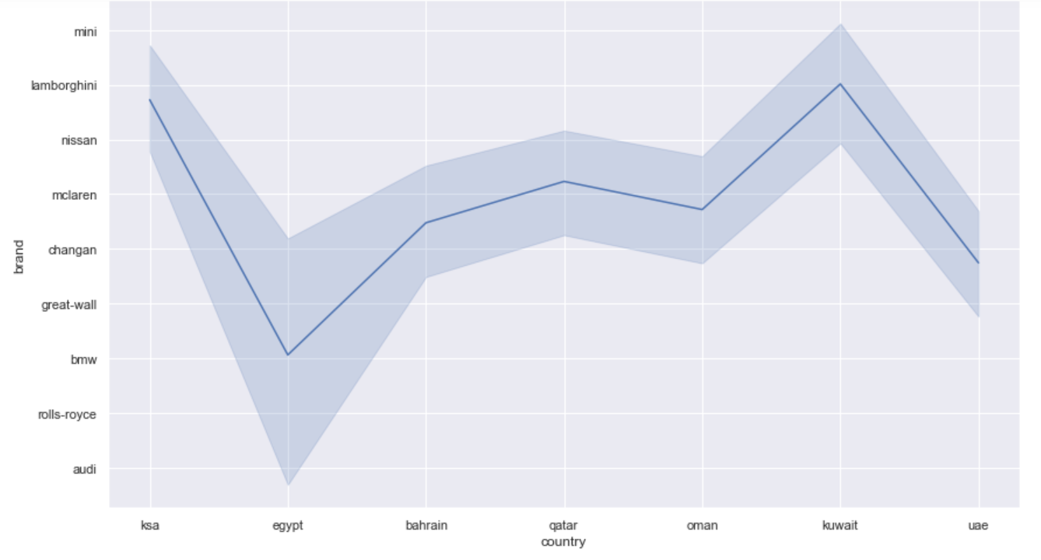
Common Brand In Each Country

Slide 7
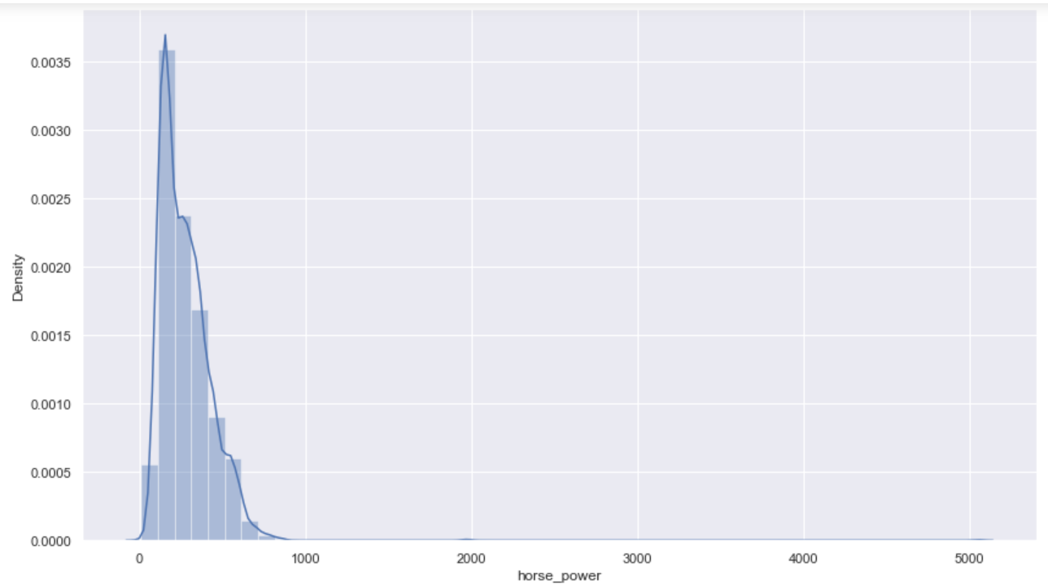
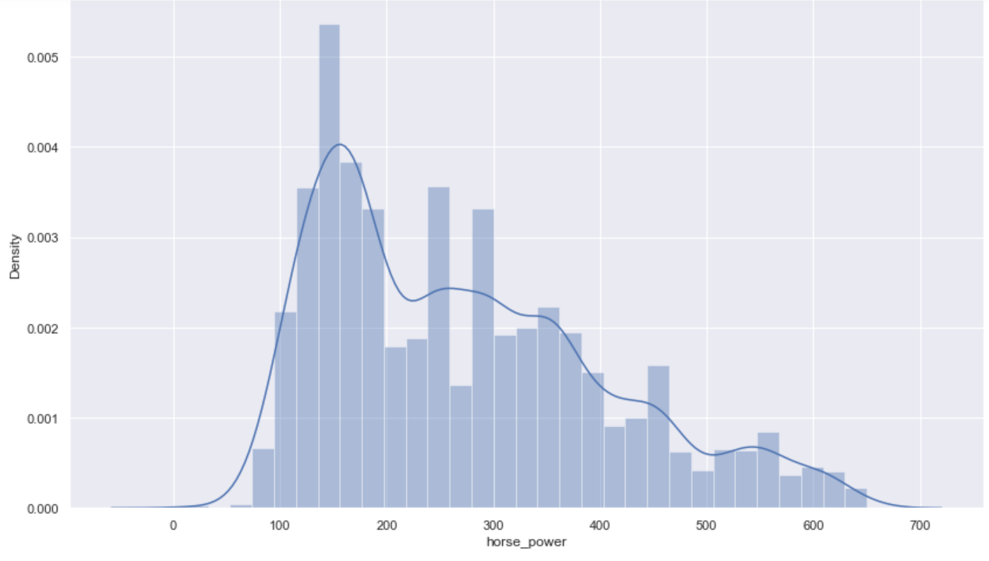
Dealing with Outliers

Slide 8
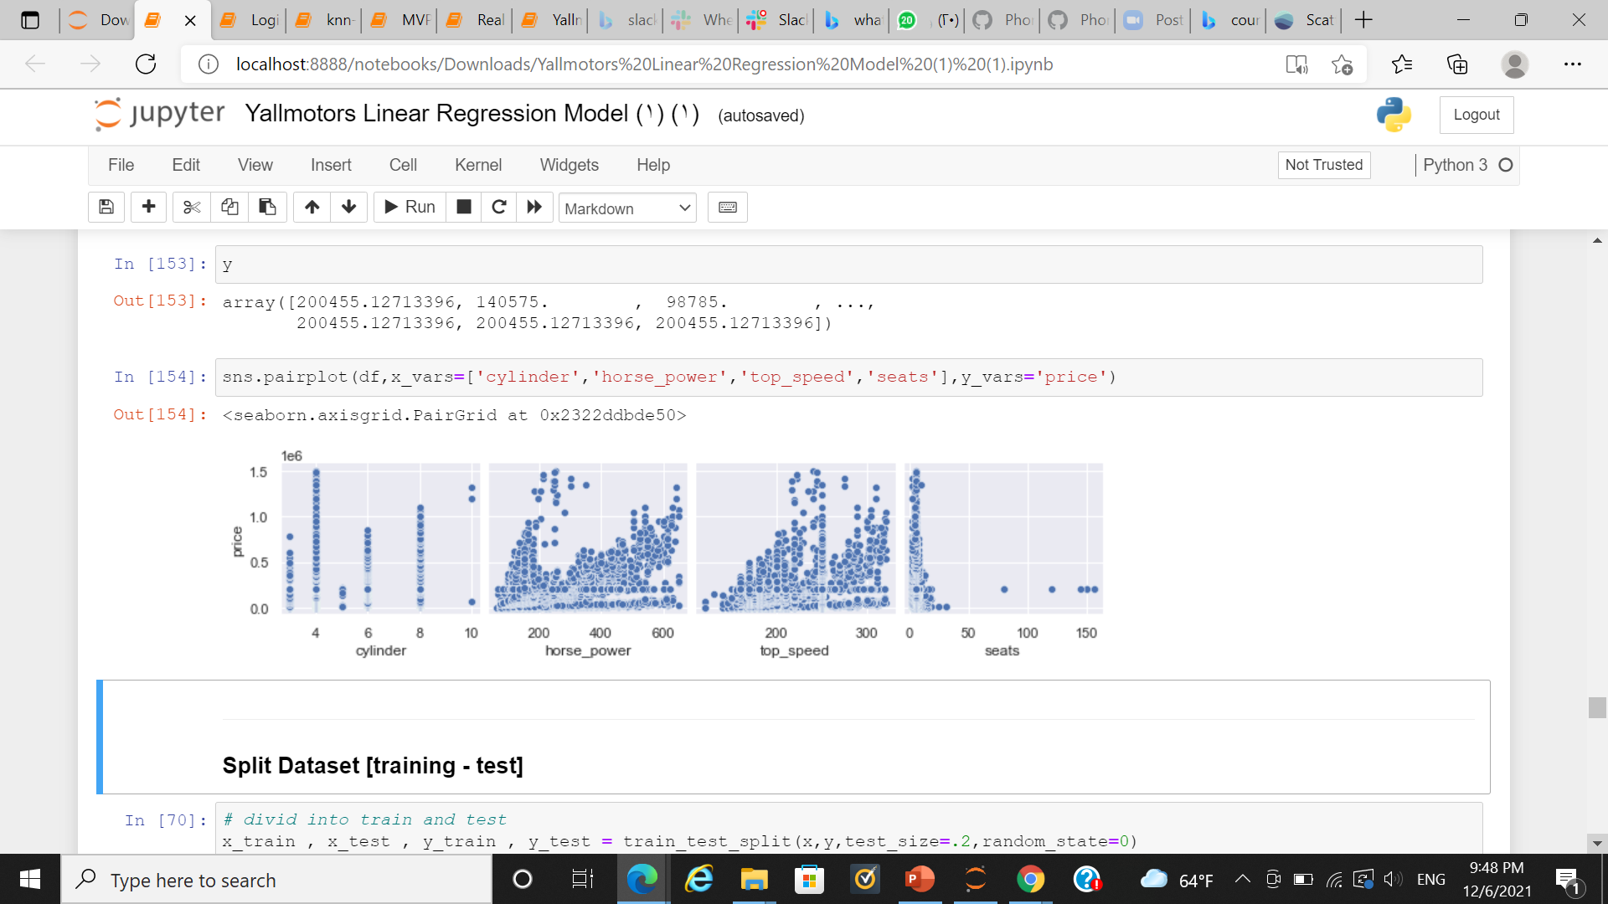
The Relation Between Features and Targets

Slide 9
Tools
Pandas
NumPy
Matplotlib
Seaborn
Scikit-learn
Math library

Slide 10
Tested Machine Learning Algorithms
R² Test | R² Train | Model
1.397- | 0.822 | Linear Regression
0.512 | 0.464 | Decision tree regressor
0.817 | 0.807 | Lasso Regression
0.588 | 0.822 | Ridge Regression
The best model Lasso Regression is then Ridge Regression

Slide 11
thanks

